Slide 1

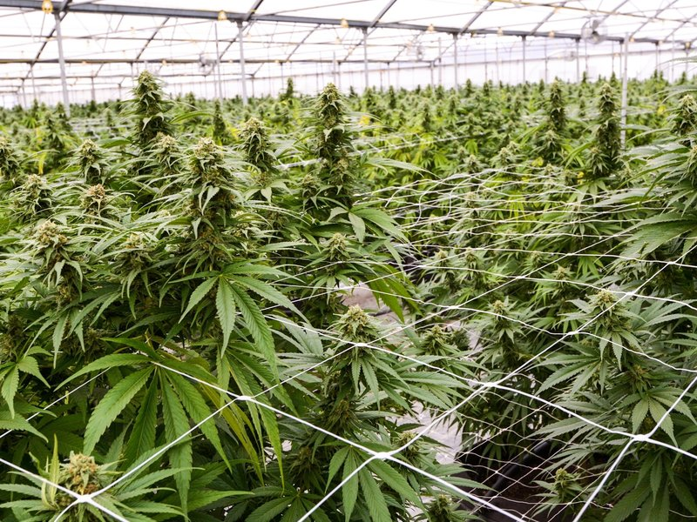
THE WAR ON CRIME
By Jeffrey Hou

Slide 2
Which Datasets were used?
For this project I wanted to focus on Crime in general and Marijuana and Burglary crimes.
I focused on Maryland, DC, and Denver as cities to compare with Montgomery County’s data
Read in LIVE: Data Montgomery

Slide 3
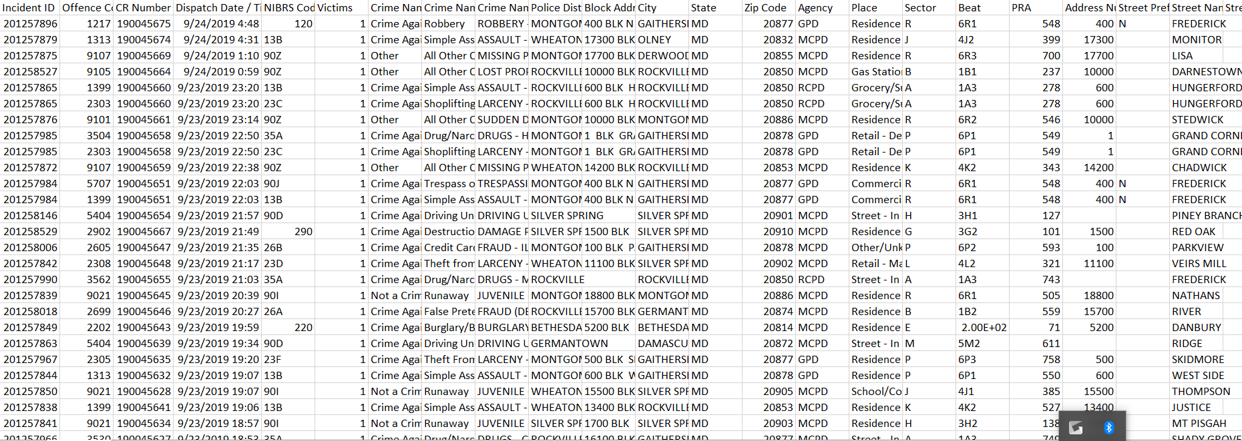
Data.Montgomery Crime Dataset
Important Variables: Crime Name 3, Dispatch Time
-Crime Name 3 is the detailed name of the crimes

Slide 4
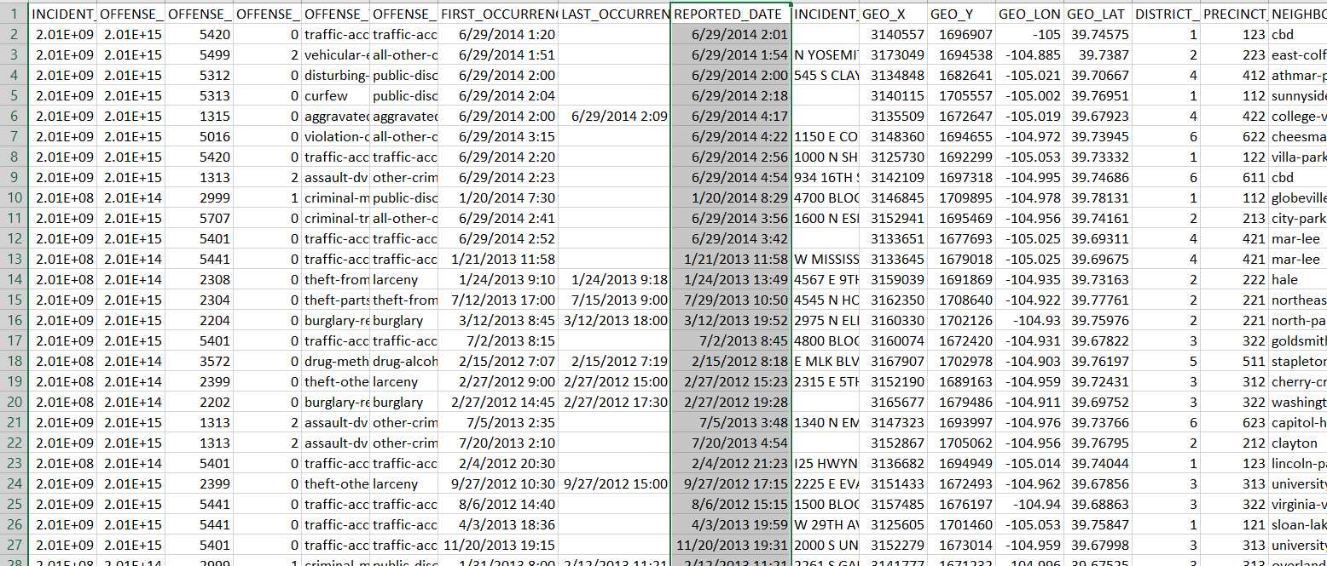
Data.world Dataset- Raw Crime Data for Denver, Colorado
Important Variables: Offense Type, Reported Date

Slide 5
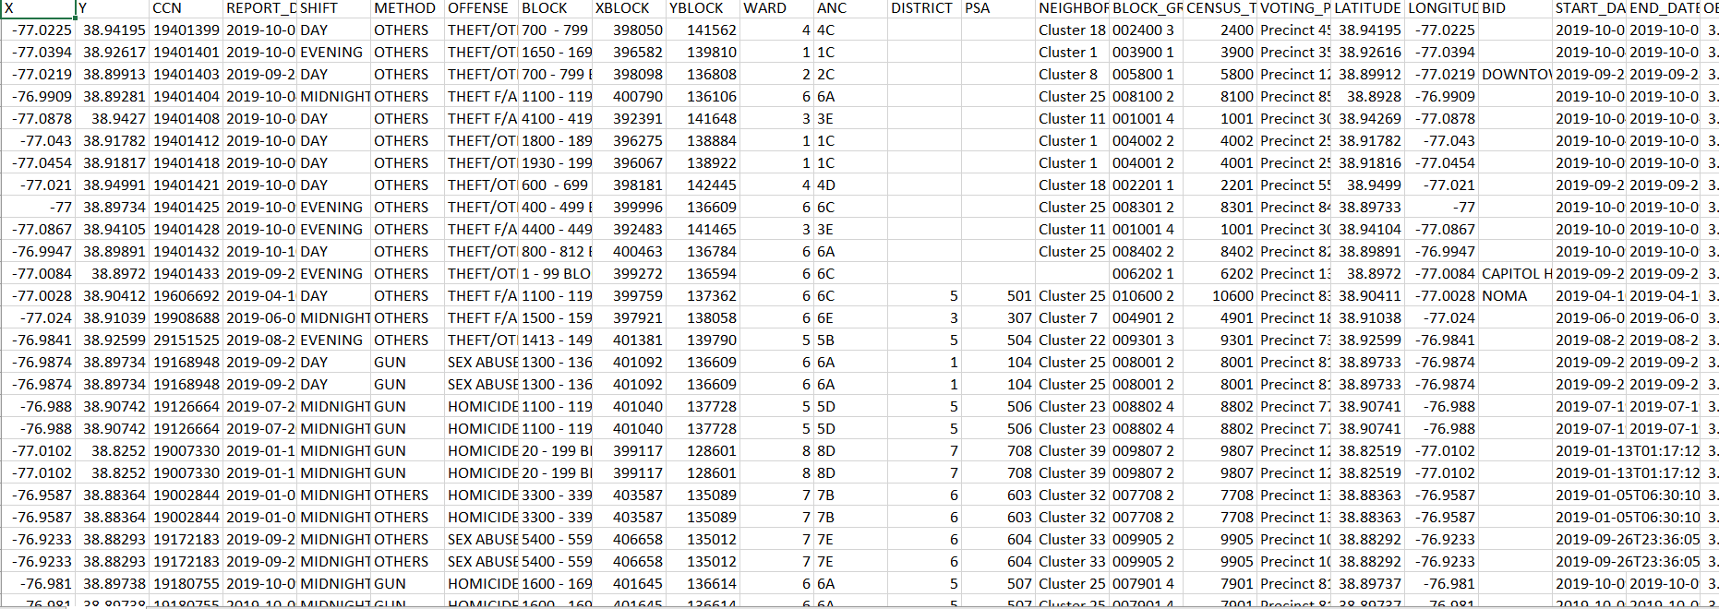
DATA. World-Washington DC Crime Incidents
Important Variables: Offense, Latitude, Longtitude

Slide 6
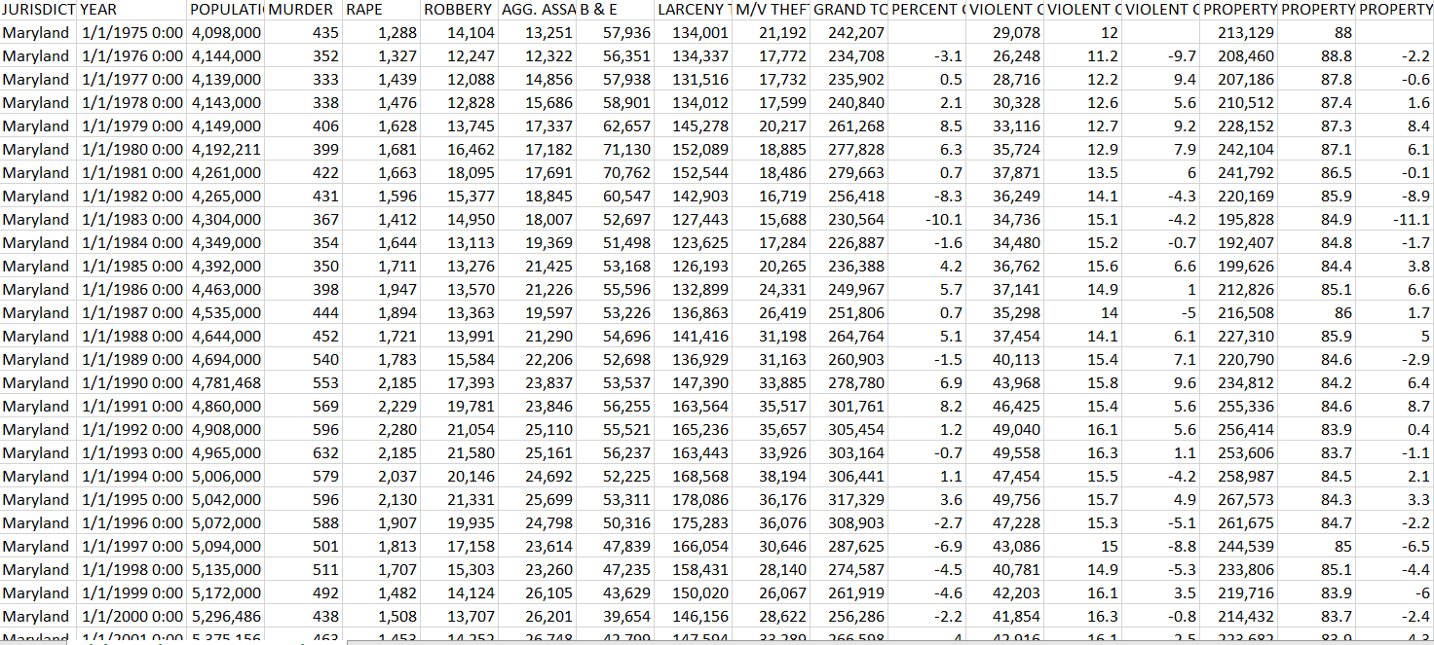
MD.Gov Dataset-Violent Crime & Property Crime Statewide Totals: 1975 to Present
Important Variables: Population, B&E

Slide 7
DATA MONTGOMERY crime Dataset
Most popular crime type 1 : Crime against property
Most popular crime type 2 : Drug/Narcotic Violations
Most popular crime type 3: Larceny-From Auto
July is the most popular month for 3 different categories: General arrests, Marijuana arrests, and Burglary arrests
Both Marijuana and burglary arrests occur more during the daytime
Majority of the arrests are made by MCPD

Slide 8
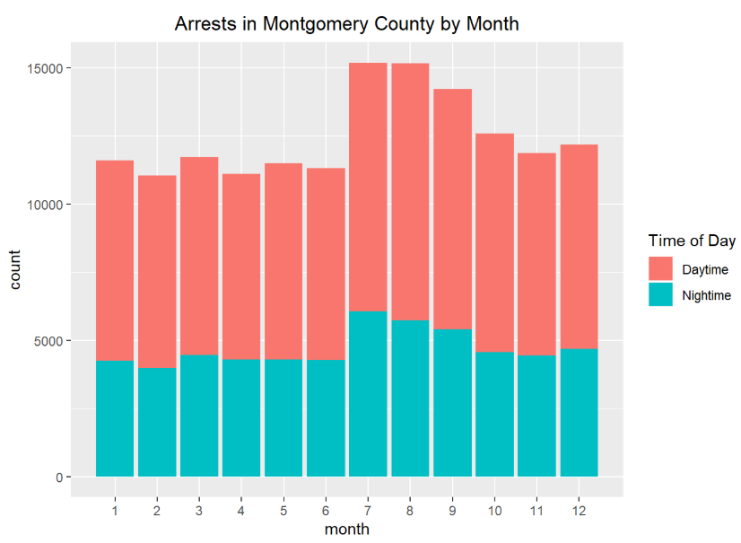
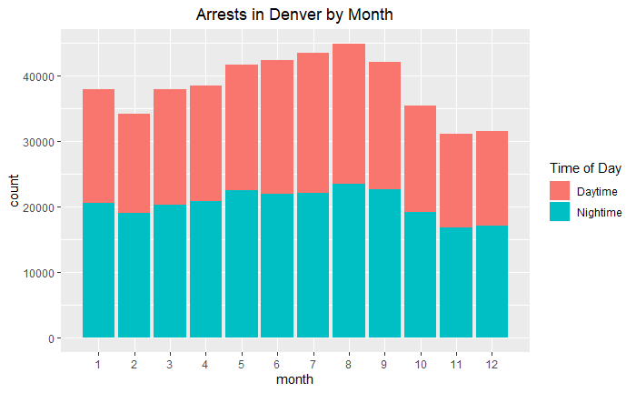
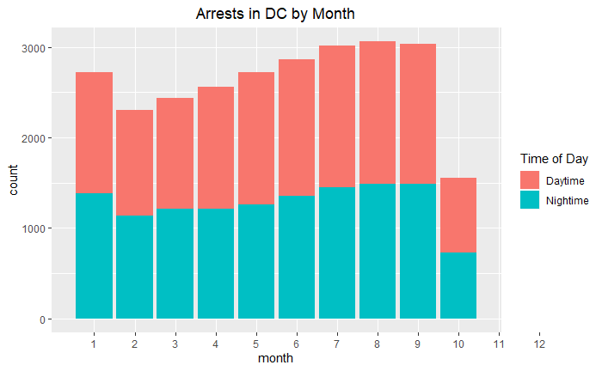
Why Are JULY, AUGUST, AND SEPTEMBER TOP MONTHS FOR CRIMES?
For all three cities, those three months always seem to have the highest rates of crimes
Increased temperatures
increased daylight hours
lengthen the amount of time people spend away from their homes and in the public

Slide 9

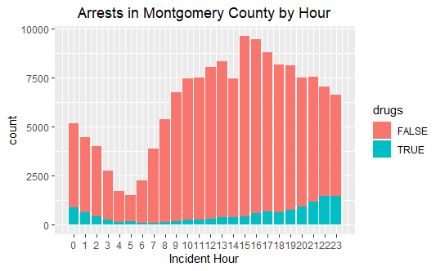
Why Are Drug Arrests More Popular at Night?
Drug related arrests are more common at night
More people tend to use drugs or distribute drugs at night to avoid being seen by the police
The popular times for arrests in Montgomery County is 3pm-4pm

Slide 10
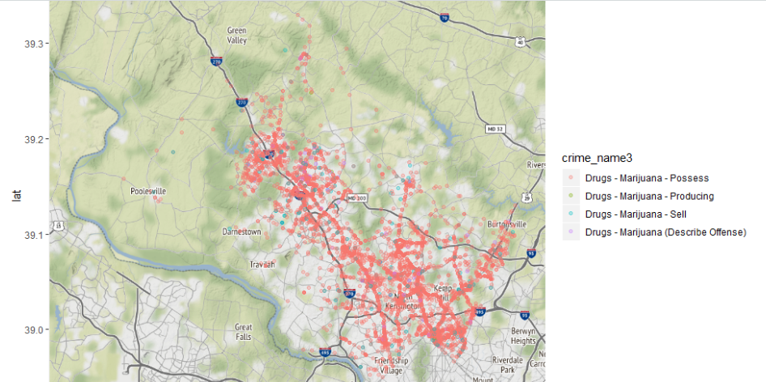
Why do Majority of DRUG arrests Occur Along I270?
Majority of the marijuana arrests are possession
Most marijuana possession charges are due to the fact of being pulled over. Very rarely does a cop pull a car over DUE to the fact they have marijuana. Most of the time the cop is just doing a routine traffic stop and they happen to search the car!
Most of the Marijuana arrests at night occur near Silver Spring
Silver Spring always seems to have the most drug crimes out of all the cities in MD, so focusing on cleaning up Silver Spring could benefit the police force!

Slide 11
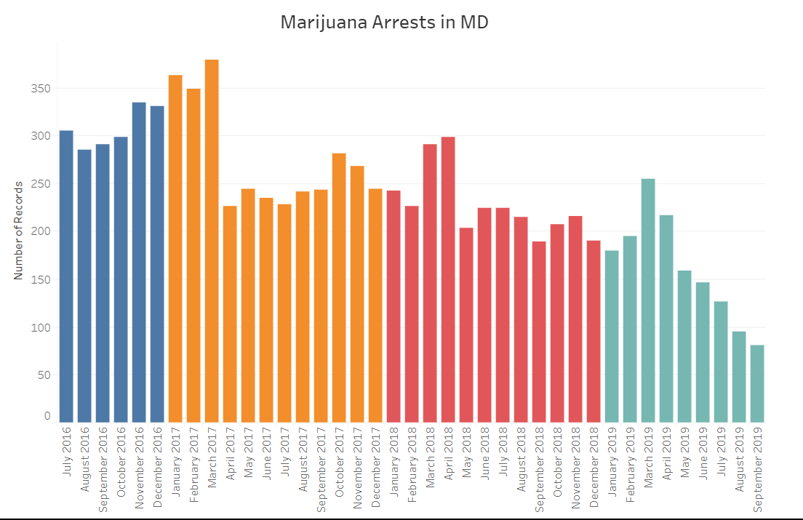
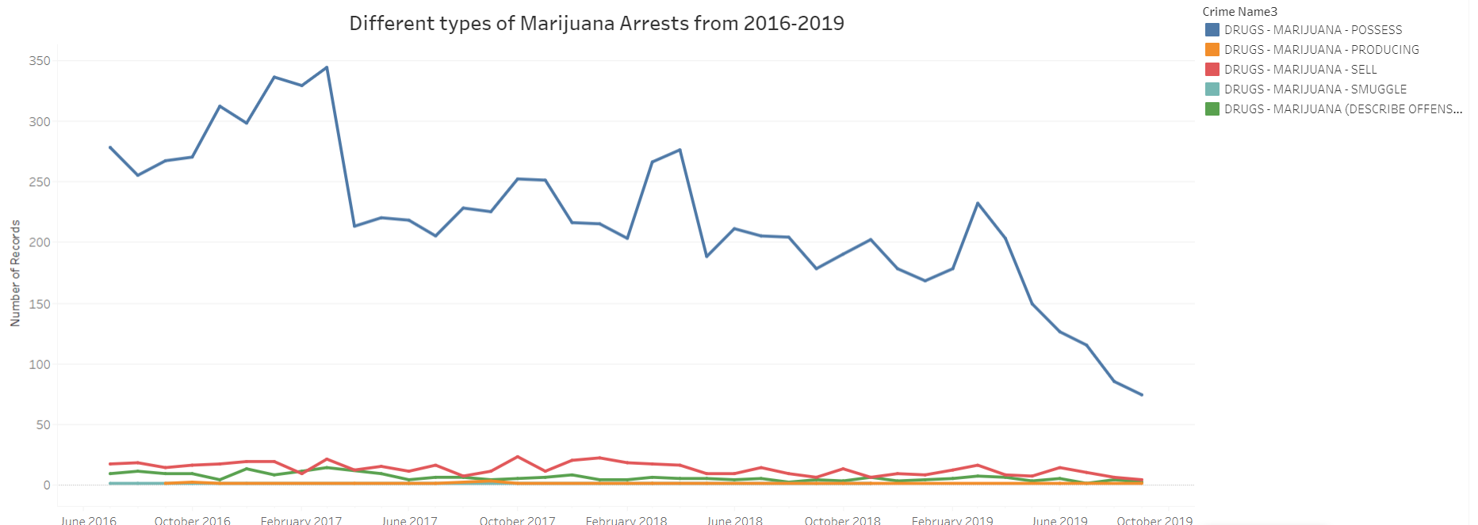
Marijuana Trends in Montgomery County

Slide 12
Crime DC Dataset TakeAWAYS
Top offense category is theft
Most popular month for crimes is August
Summer months have increased crime
Most popular month for burglary crimes is May
Steady increase in arrests from February till September, peak is August

Slide 13
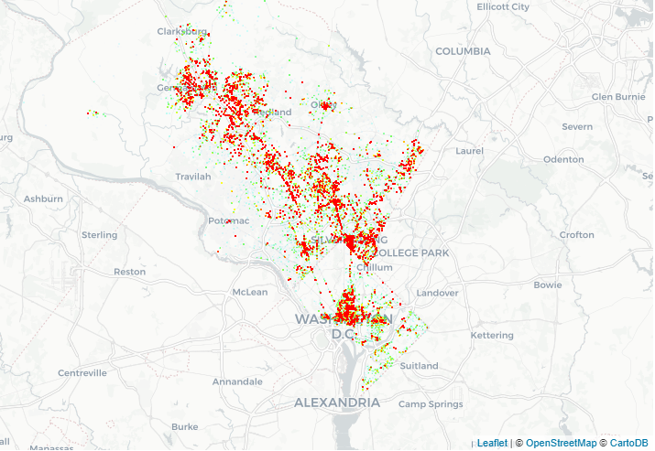
DC AND MD HEAT MAP
Majority of the crimes occur in Northwest DC, as well as near the Silver Spring/College Park area
Increase police activity near the border between DC and MD, lots of marijuana arrests can be made there
Marijuana is legal in DC, illegal in MD, many people get caught on the borders!

Slide 14
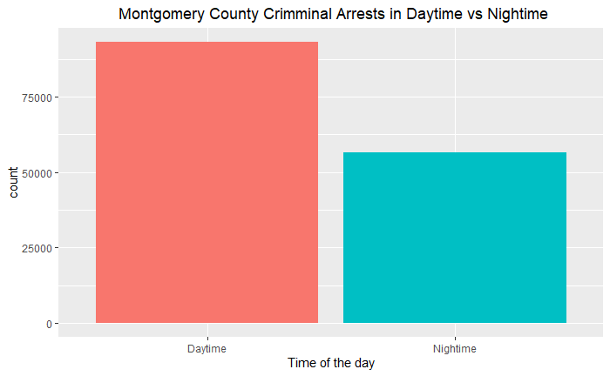
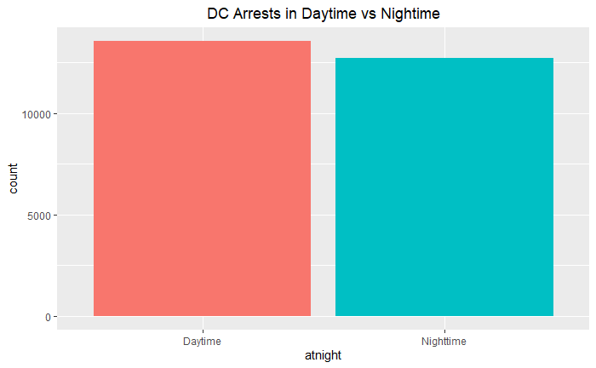
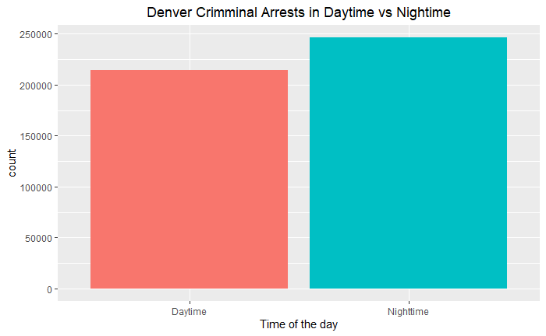
WHEN DO ARRESTS HAPPEN?
Bigger cities tend to have more crimes committed at night
Bigger cities tend to have more violent crimes committed
Scared to commit big crime in the day time

Slide 15
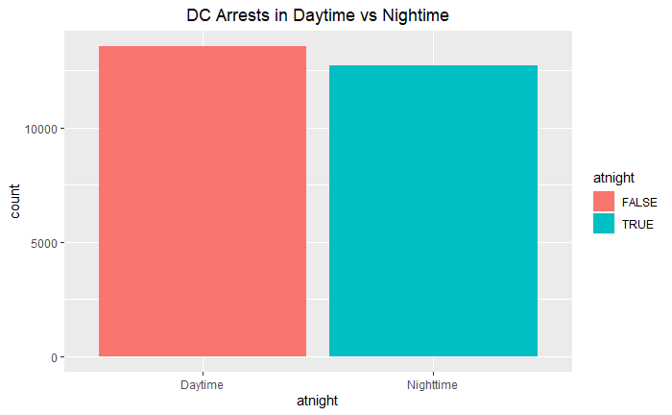
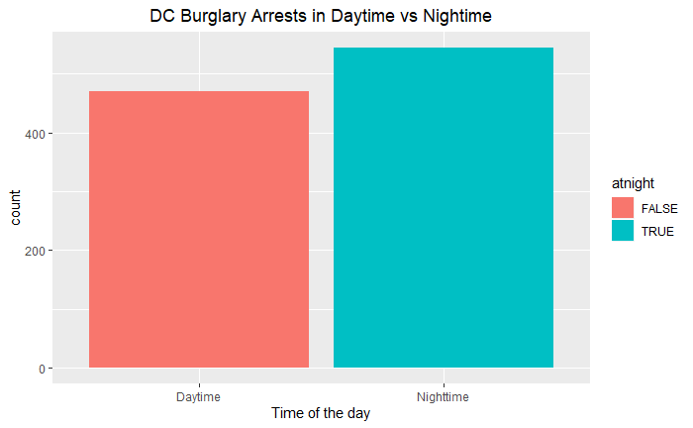
DC- Burglary Arrests
More general daytime arrests compared to nighttime, but more night time burglary arrests

Slide 16
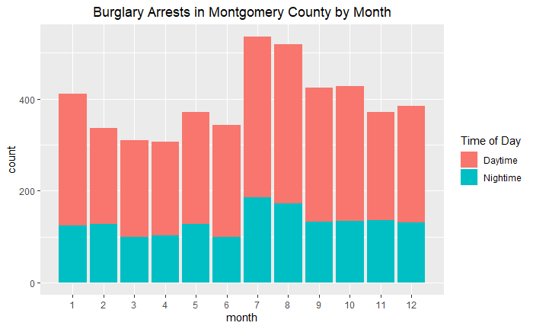
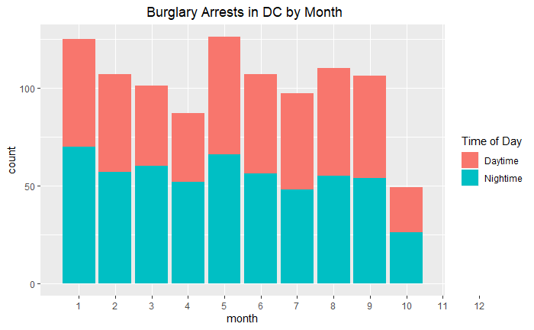
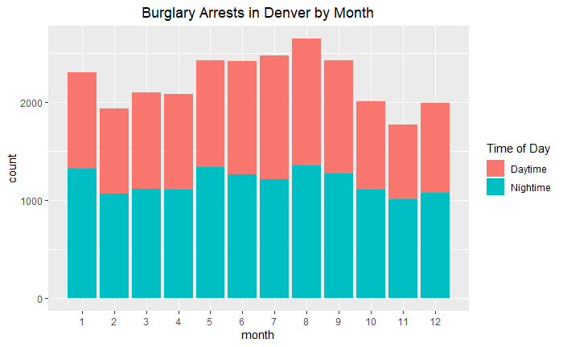
Burglary arrests in 3 different Cities
MOCO
DC
DENVER
DC follows a unique pattern of 3 month intervals
Both Montgomery County and Denver have peaks at July-August

Slide 17
CRIME DENVER Dataset OBSERVATIONS
Top crime type in Denver is traffic accidents
Important to note that many states with legalized marijuana are among the top in car accidents
More nighttime arrests compared to daytime
More nighttime burglary arrests compared to daytime
Harder to steal in the daytime, people walking around

Slide 18
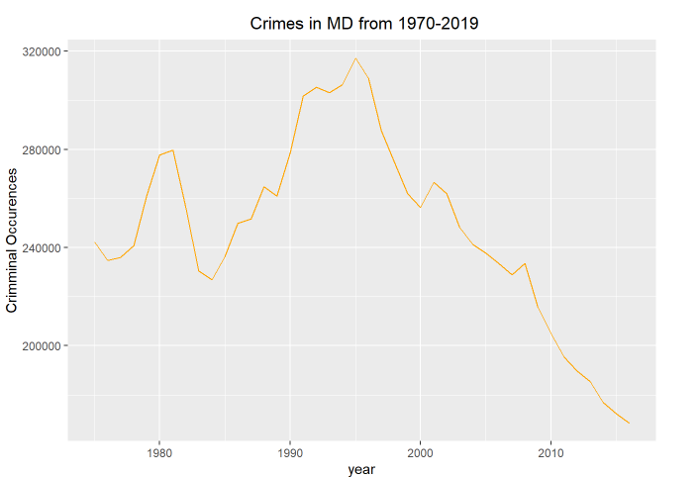
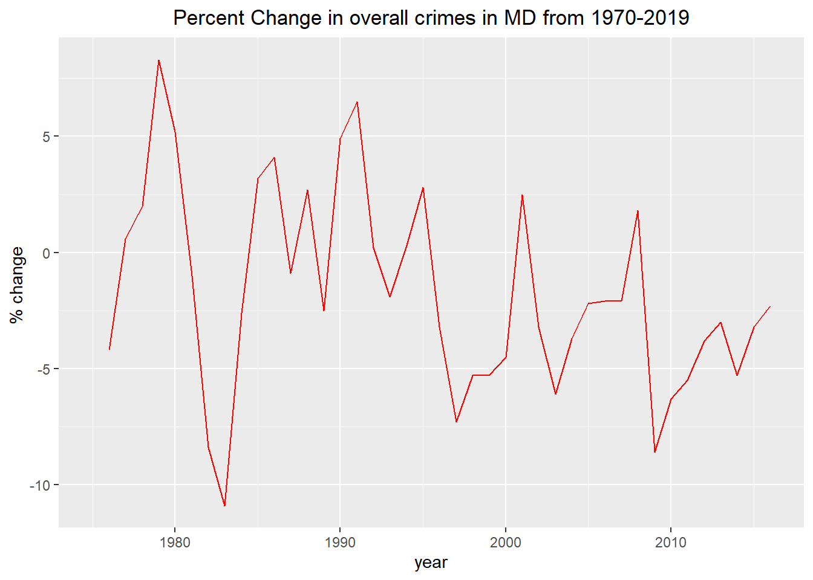
MD CRIME TRENDS
Overall crimes in MD have gone steadily down since 1995, and are currently at its lowest in 40 years.
The sharp decrease in crimes in MD from 1980-1983 is seen through this graph
Almost a 20 percent difference in 5 years.

Slide 19
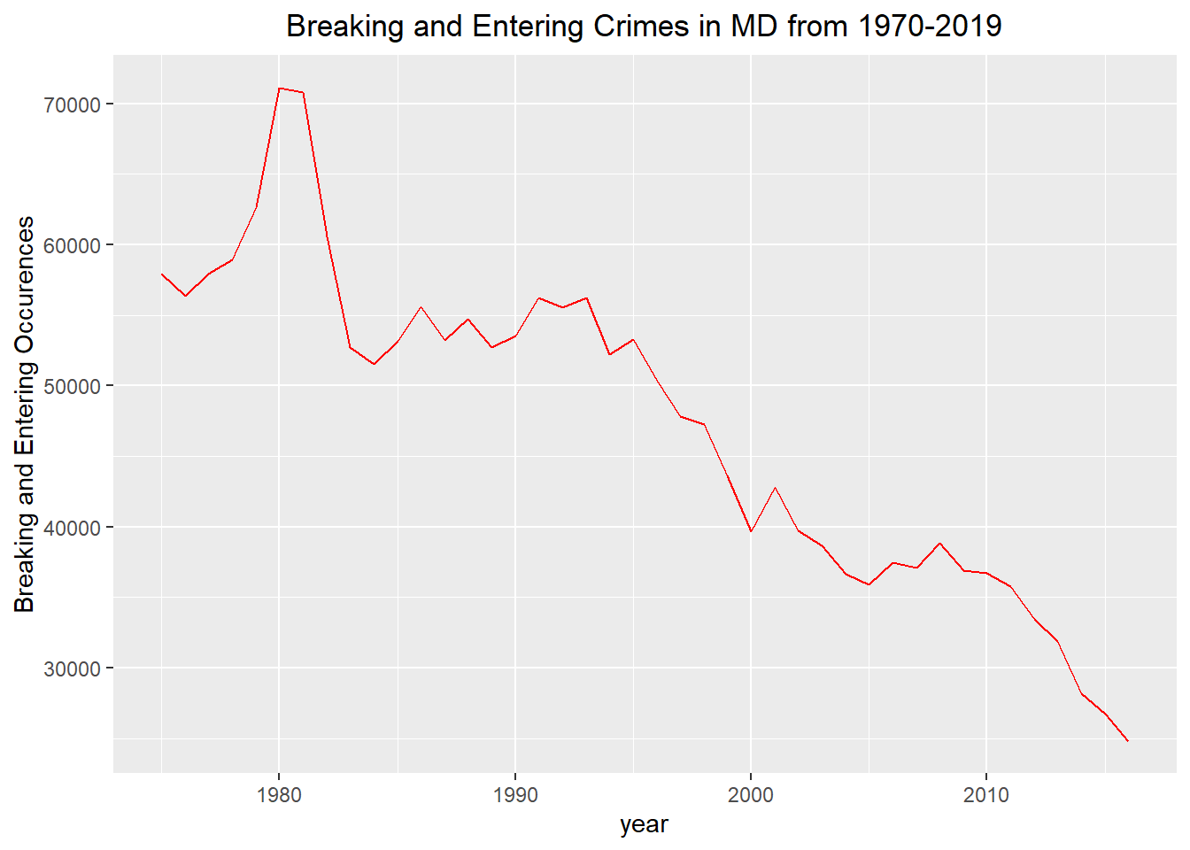
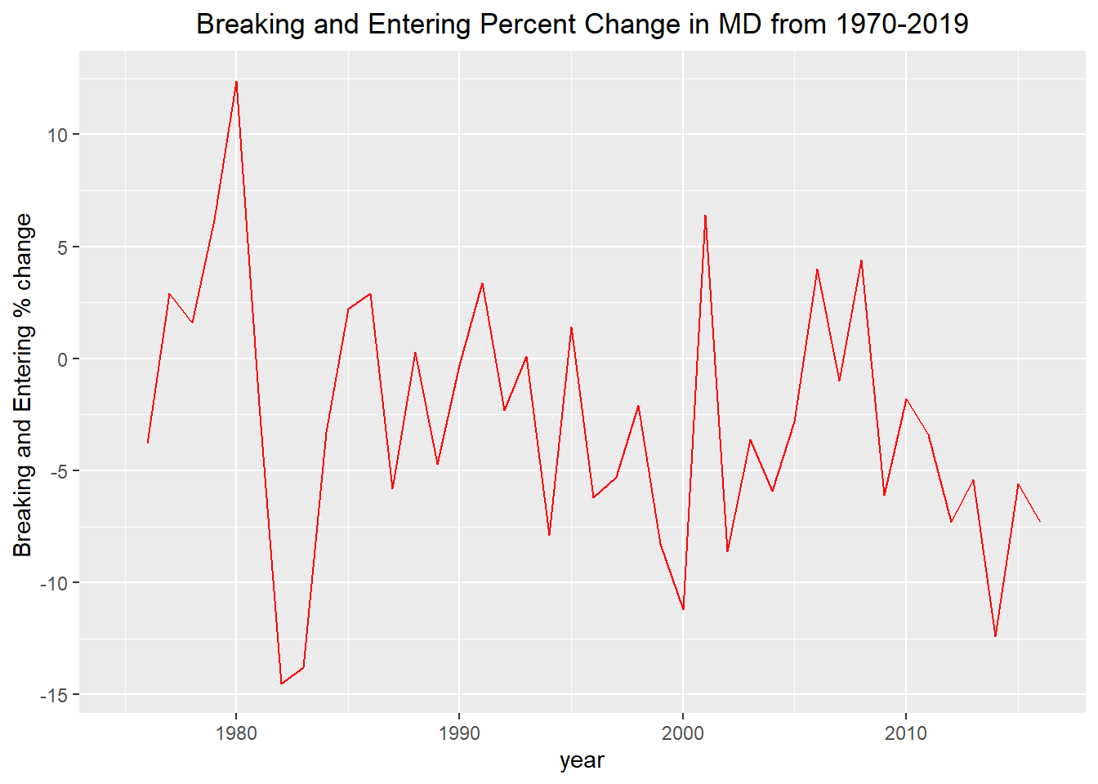
WHY THE BIG DROP IN BREAKING AND ENTERING?
Sharp decrease in breaking and entering crimes in MD from 1980-1983.
Castle Doctrine-Allowed deadly force when in self defense, decreased the amount of people trying to break into other people’s homes.

Slide 20
Recommendations
Include gender, race, age in the Arrest info
Include information such as if the person was jailed or not
Predict pockets of crime in Montgomery County using current data

Slide 21
THANK YOU !!!!!!!!!!!!!!
Dennis Linders- for providing us with the direction and oversight of our projects!
Montgomery County Government-Providing us these great resources to work on our projects
Victoria Lewis, data Montgomery-Providing us with their great datasets and allowing us to analyze them!

